Slide 1

“ E-Commerce Web Application ” Task - 1
SUNSTONE

Slide 2

SUNSTONE
Project Name : “ E-Commerce Web Application ”
An e-commerce website is one that allows people to buy and sell physical goods, services, and digital products over the internet rather than at a brick-and-mortar location. Through an e-commerce website, a business can process orders, accept payments, manage shipping and logistics, and provide customer service.
S.NO | LMS Username | Name | Batch
1 | @sakthivel3031 | Sakthivel | 8
2 | @erakashkumaryadav | Akash Kumar Yadav | 8
3 | @sharmakarnan | Sharma | 8
4 | @Tharun2192 | Tharun | 8

Slide 3
Task-3
Creation of SRS and Github
Draw and design a uniform front end code for “Your Project”
Draw and design a interactive front end code for “Your Project”
SUNSTONE
Evaluation Metric:
100% Completion of the above tasks
Learning Outcome
Developing complicated UI using HTML components
Using props drilling and context to pass variables
Getting familiar with different type of API calls
Handling different input data

Slide 4
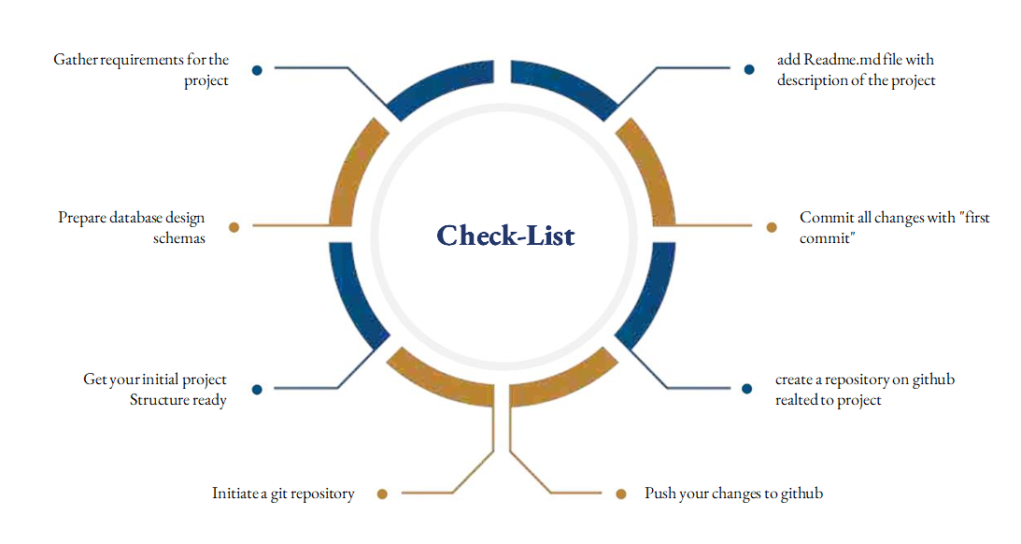
SUNSTONE
Assesment Parameter

Slide 5

SUNSTONE
Submission Github
https://github.com/sakthivel3031/NM-AIT-GROUP8

Slide 6


SUNSTONE

